Slide 1
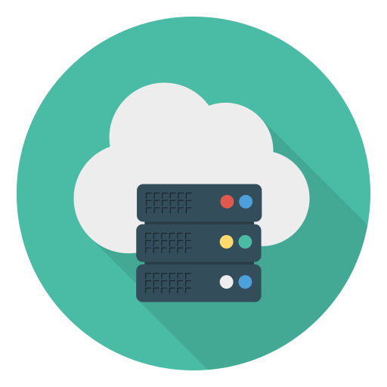




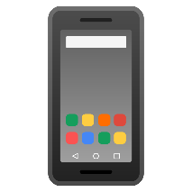

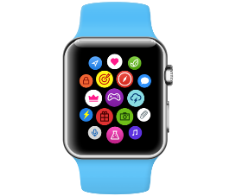
Model Aggregation
Global Server
Local Data
Local Trained Model
Model Download
Model Upload
Global Model
Smart Phone
Mobile Computer
Smart Watch
Local Training
Local Training
Local Training

Slide 2
Model Aggregation
Global Server
Local Data
Local Trained Model
Model Download
Model Upload
Global Model
Smart Phone
Mobile Computer
Smart Watch
Local Training
Local Training
Local Training

